Slide 1
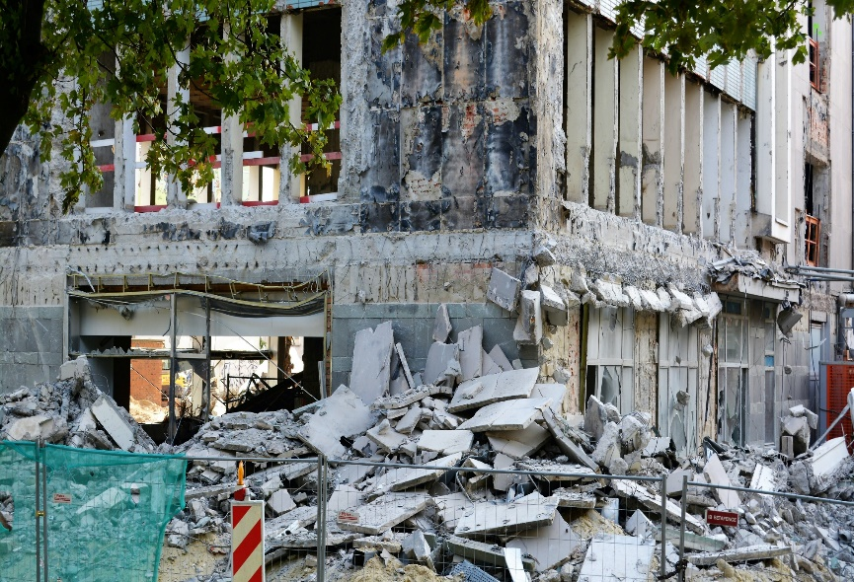
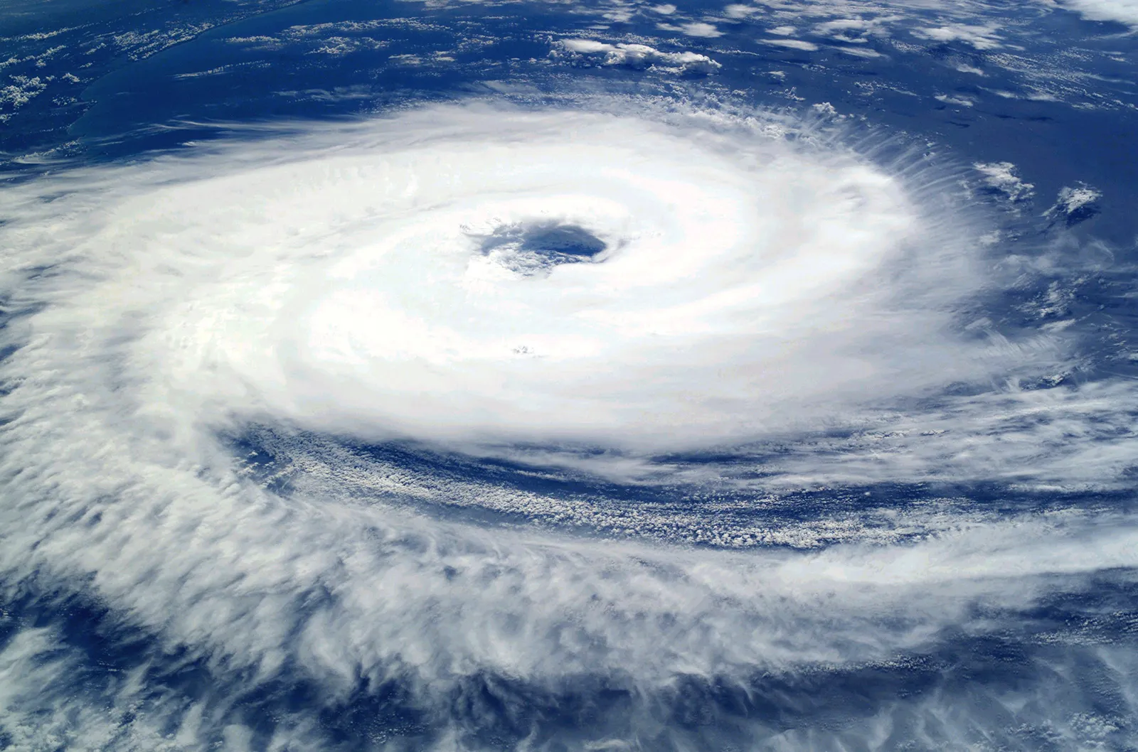
HOW CAN AI HELP IN SOLVING NATURAL CALAMITIES MORE EASILY?
01
LET’S HAVE A LOOK AT THEM AND TRY TO FIND THE SOLUTION!!!
EARTHQUAKE
CYCLONES

Slide 2
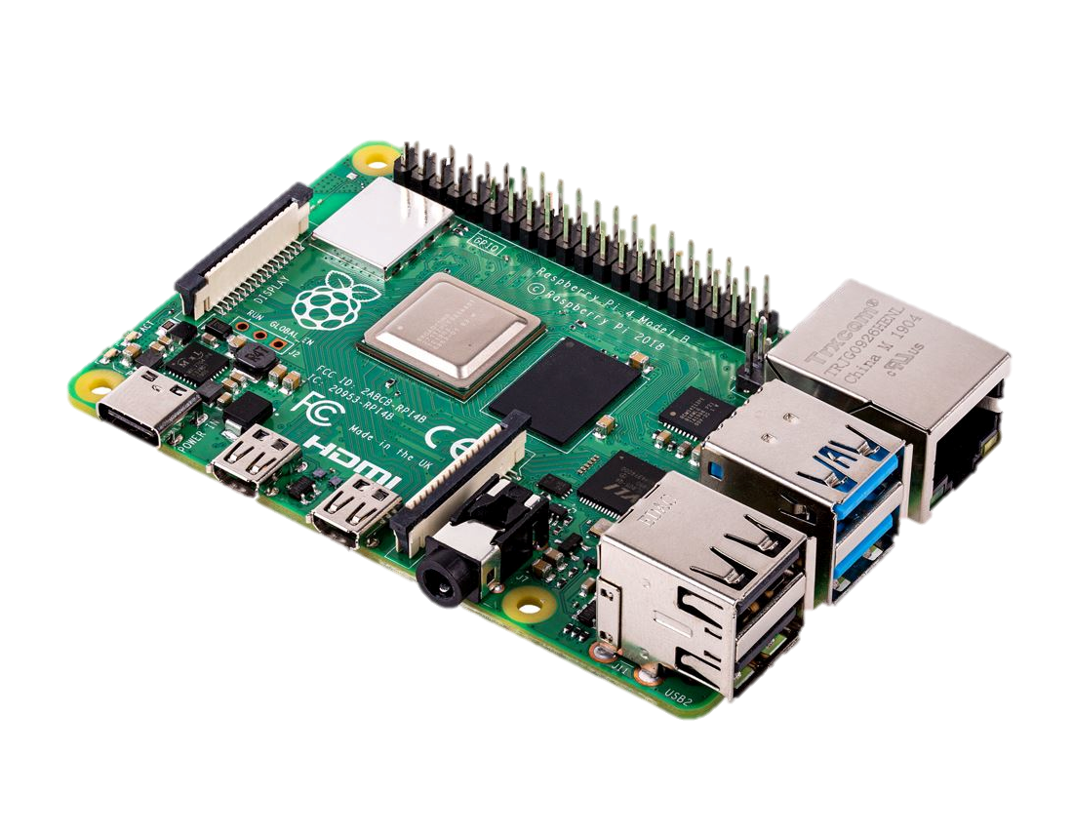
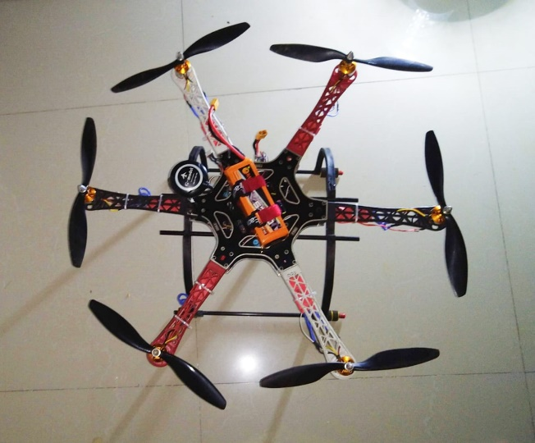
02
So Let’s us see How will the solution work…
The communication between the ground station and with the UAV will be established using radio communication at 2.4ghz
The single board computer present in the vehicle will be programmed with certain types of algorithm based on A.I and M.L.
Then the flight controller along with its thermal and infrared camera and algorithms programmed in the single board computer will find out any living object present in the situation.
And after executing all the task it will simply follow its last command which is rtl(return to launch).
P.S-THIS WAS CREATED BY ME!

Slide 3
SAME APPLIES IN THE CASE OF CYCLONES BUT WITH DIFFERENT APPROACH!!!
03
During cyclones transportation of things to the right person gets difficult so in order to make it easier what we will be doing is we will be establishing a real-time connection between the UIDAI servers and the UAV so that we can identify ev0eryone before the delivery..
During cyclones in some cases it may happen that thermal sensors cannot give accurate result so in such case we will be using sonar or ultrasound techniques to get more accurate results in terms of searching human beings.
We will also be using a GPS to avoid any loss of communication with the vehicle.
Radio communication with uav
Processing takes place in the SBC &FC
Acc. To needs sensors works
Task execution completed
RTL.

Slide 4

04

